Slide 1
New Era of ST 2110 Testing with PICS and RP 2110-25
Willem Vermost Pavlo Kondratenko
wim.vermost@vrt.be kondratenko@ebu.ch

Slide 2



JT-NM Tested program
IP Showcase
SEPTEMBRE 2022 ©
IBC 2022 - IP SHOWCASE
Pavlo Kondratenko - Willem Vermost
EBU
TECHNOLOGY & INNOVATION
Notes:
WV

Slide 3


What JT-NM Tested?
The JT-NM Tested program offers documented insight into how vendor equipment conforms to specific SMPTE standards and AMWA NMOS specifications. Vendors who meet the testing criteria will have the opportunity to display badges and make public statements about their participation. The JT-NM Tested Catalog lists vendor results along with a detailed test plan. Anyone with the equipment listed in the test plan may execute the tests which were administered by the JT-NM test team, and you are encouraged to do so.
It is important to note that the JT-NM Tested program is not a certification program; rather, it is a snapshot in time of how vendor equipment conforms to key parts of SMPTE standards and AMWA NMOS specifications.

Slide 4


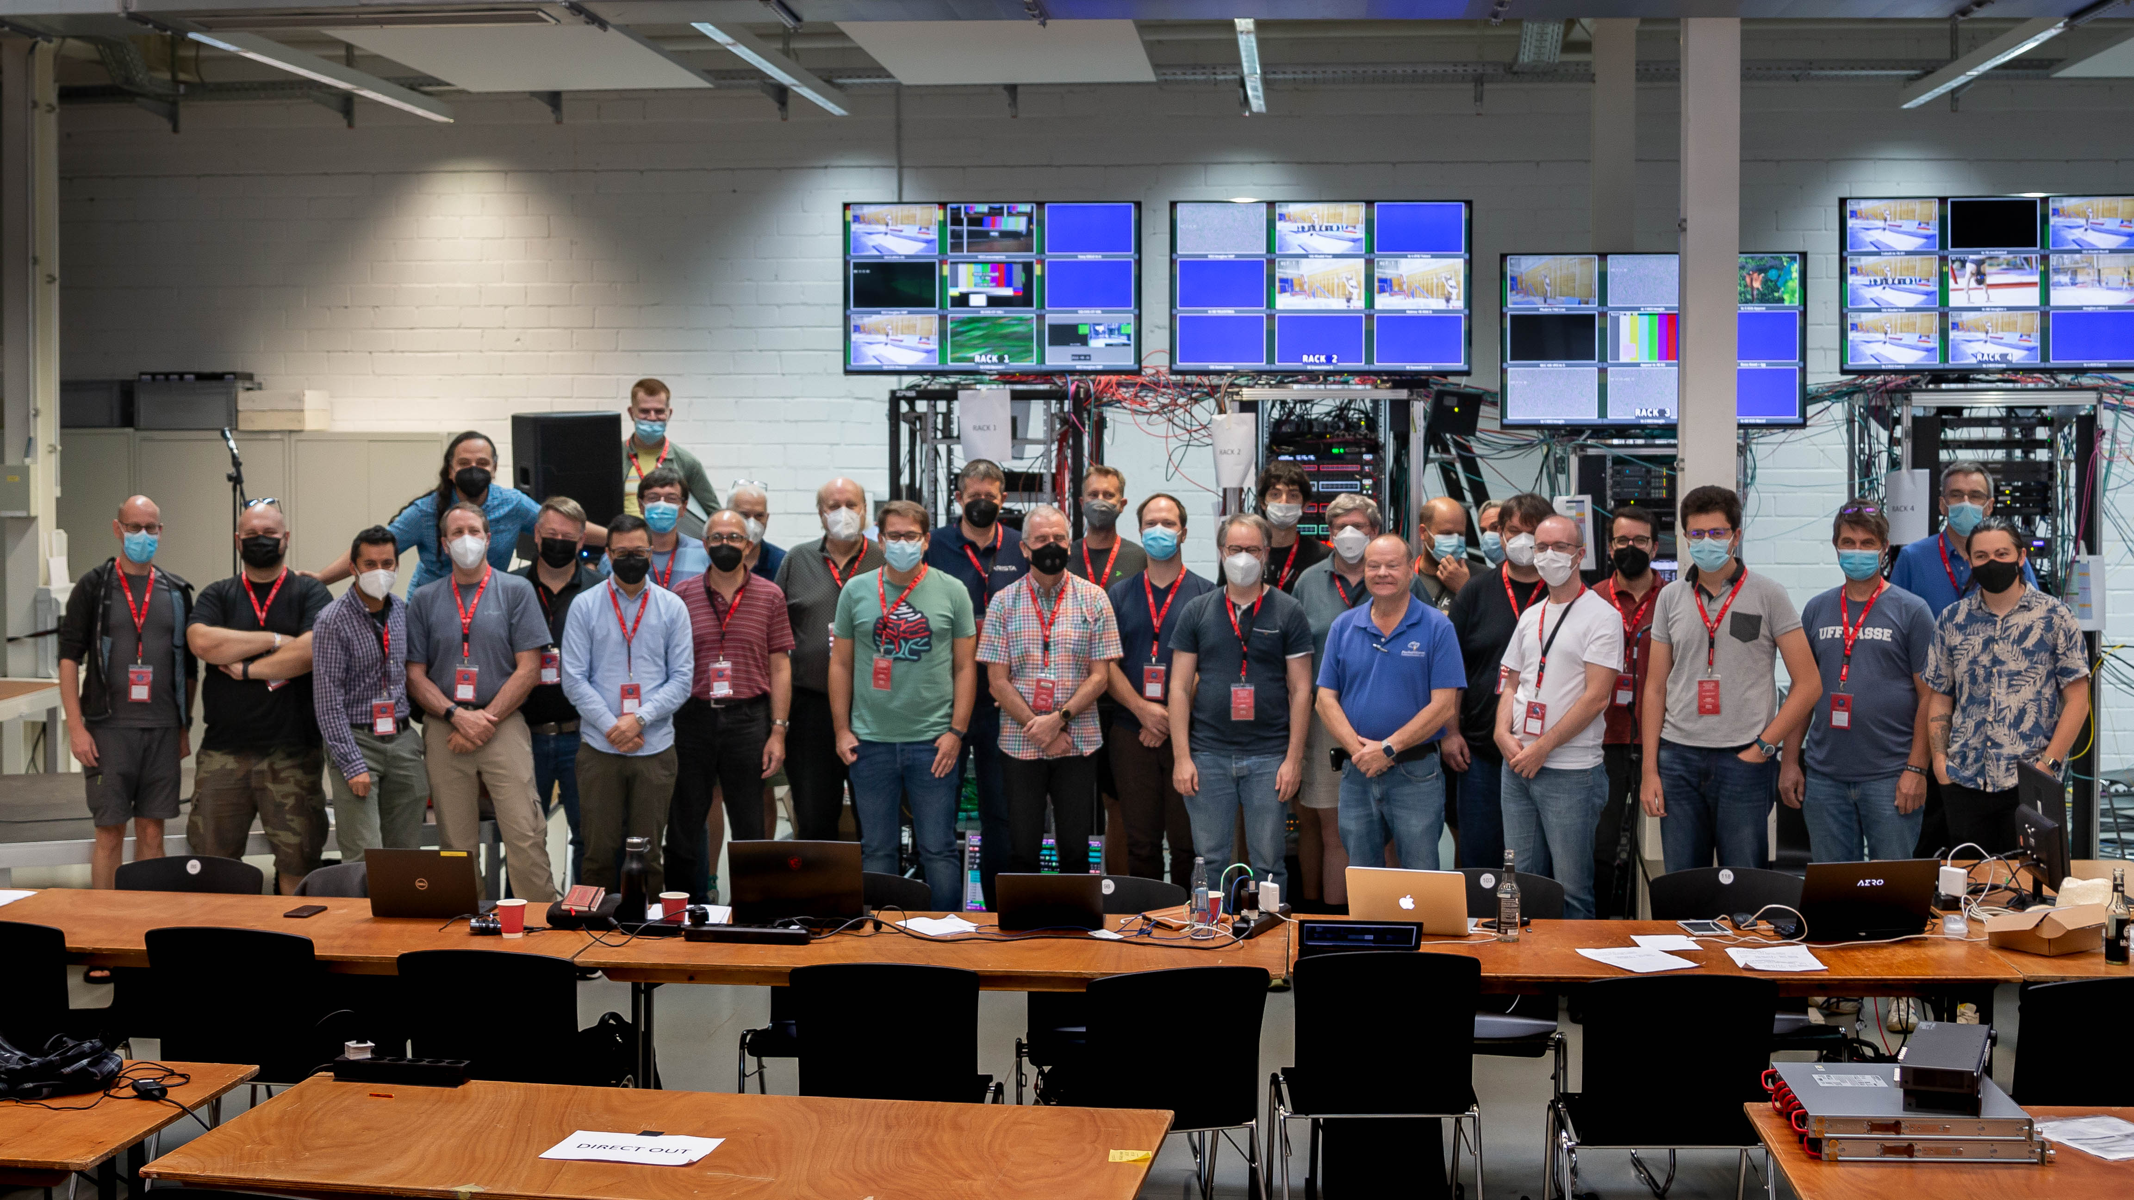


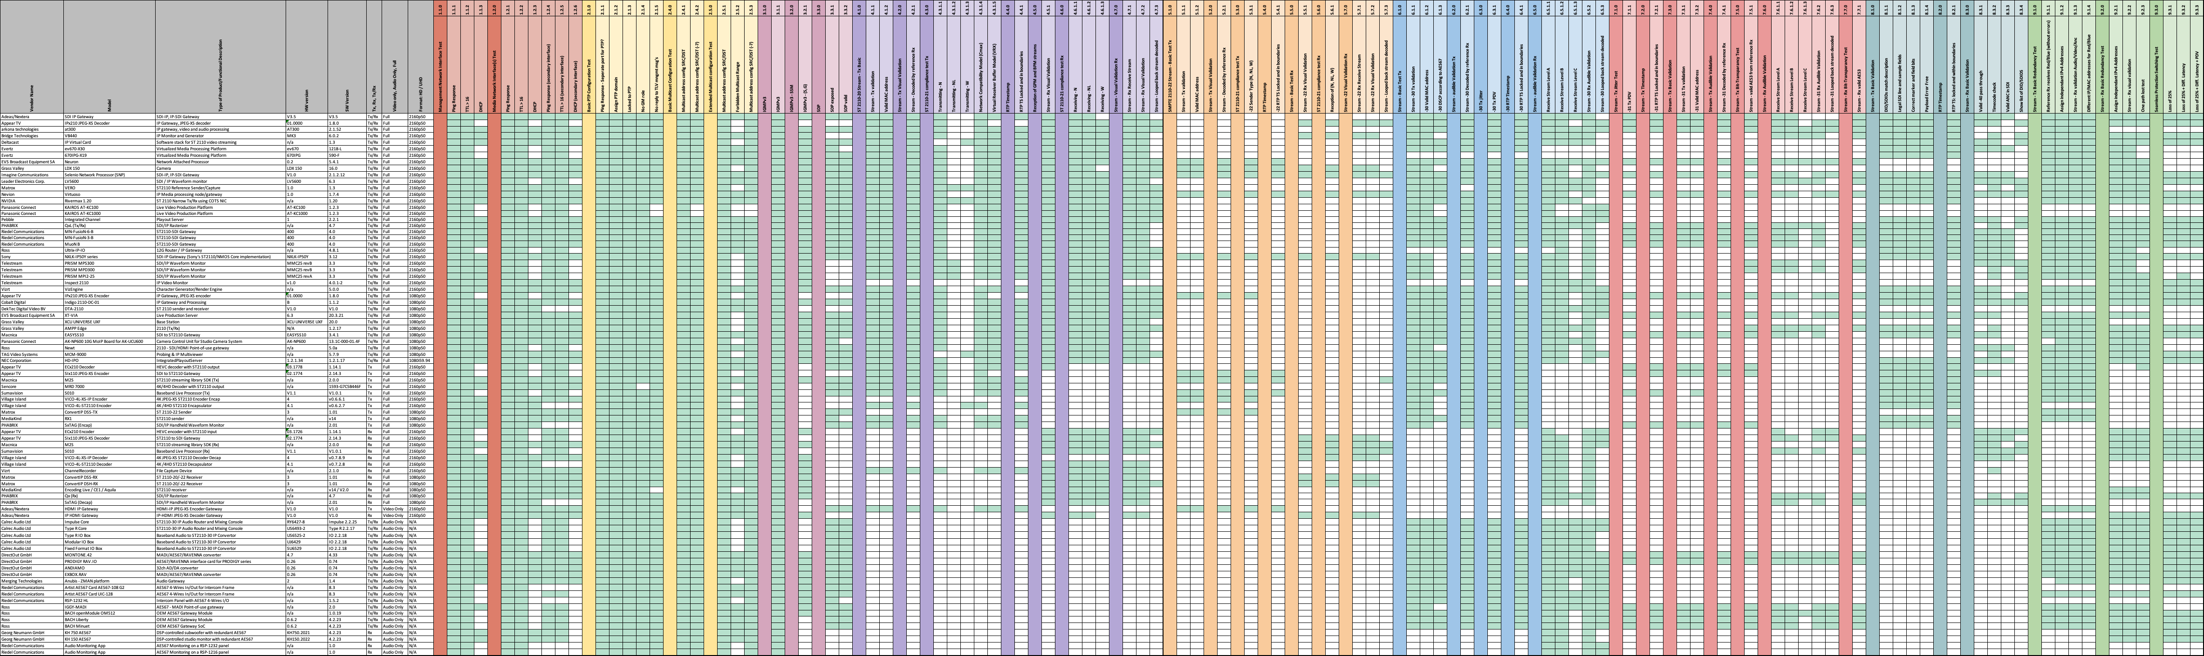
AUGUST 2022
JT-NM Tested PROGRAM

Slide 5
The road towards the tested event
While drafting the standard, early T&M solutions came available
Multiple “Dirty hands” events were held
  to check the theory in real-life
IP showcase: technology demonstrator
IBC 2017: SMPTE ST 2110 officially published
From “dirty hands” to JT-NM Tested event
A tested event needs two major things:
  Test & Measurement equipment
  A set of tests to perform

Slide 6
What are the 2 problems?
Moving from creating the document to a published standard, measurement tools were already available. As a result, not using the same nomenclature for certain measurements and even not the same formulas. (SMPTE RP 2110-25)
When creating the test document what tests are applicable? Sometimes it was hard to figure out, even amongst top experts, what specific part of the standard is mandatory and what’s not? The PICS work brings a solution.
Notes:
JT-NM Tested
When measuring: formulas and nomenclature
When creating the test document what tests are applicable?
and to make clear if something is mandatory in the standard (Shall Should and May)
2 problems, therefore the solution is two folded:
SMPTE RP 2110-25
PICS

Slide 7
What’s the 1st problem?
During the 2019 JT-NM Tested Event in Houston, the test team had access to a variety of test equipment, each with his or her specific specialty but also a fair amount of overlap of measurements. The overlapping measurements were conveniently used to ensure consistency of test and measurement equipment on the one hand, but also to simply have confirmation of the measurement on the other. It didn't take much time or the test team had to deal with a Babylonian confusion.
Most of the test kit had been created in parallel with the writing of the SMPTE ST 2110 standard suite. Since nomenclature and formulas may be in flux until the document is published, or simply do not specify a practical test for a particular concept being introduced; not all test and measurement kits use exactly the same nomenclature or formulas that probably should do the same thing.

Slide 8

Avoiding Babylonian Confusion
WHAT ARE WE FIXING?
S
N
R
Agree on a set of measurements
Agree on some naming conventions
Agree on the formulas

Slide 9
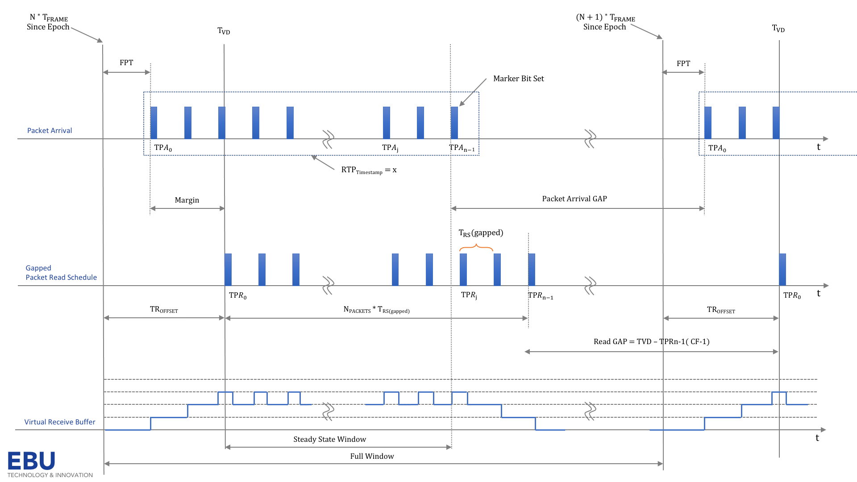
Avoiding Babylonian Confusion
WHAT ARE WE FIXING?
Agree on a set of measurements
Agree on some naming conventions
Agree on the formulas

Slide 10













$${N }^{∗}{ T}_{FRAME}$$
Since Epoch
$${(N+1) }^{∗}{ T}_{FRAME}$$
Since Epoch
$${ T}_{VD}$$
$${ T}_{VD}$$
FPT
FPT
Marker Bit Set
Packet Arrival
$${ TPA}_{0}$$
$${ TPA}_{j}$$
$${ TPA}_{n−}1$$
$${ TPA}_{0}$$
t
RTP_{Timestamp} = x
Margin
Packet Arrival GAP
$${ T}_{RS}(gapped)$$
Gapped
Packet Read Schedule
$${ TPR}_{0}$$
$${ TPR}_{j}$$
$${ TPR}_{n−1}$$
$${ TPR}_{0}$$
t
TR_{OFFSET}
N_{PACKETS} * T_{RS(gapped)}
TR_{OFFSET}
Read GAP = TVD – TPRn-1( CF-1)
Work in Progress
Virtual Receive Buffer
Steady State Window
t
EBU
Full Window
TECHNOLOGY & INNOVATION
Notes:
Packets arrive at the receiver
Are stored in the receiver’s buffer
Are consumed from this buffer at the pace of the packet read schedule

Slide 11
$${N }^{∗}{ T}_{FRAME}$$
Since Epoch
$${(N+1) }^{∗}{ T}_{FRAME}$$
Since Epoch
$${ T}_{VD}$$
FPT = TPA₀ – N * T_{FRAME}
$${ T}_{VD}$$
FPT
FPT
Marker Bit Set
Packet Arrival
$${ TPA}_{0}$$
$${ TPA}_{j}$$
$${ TPA}_{n−}1$$
$${ TPA}_{0}$$
t
RTP_{Timestamp} = x
Margin
Packet Arrival GAP
Video Timing, Video to PTP, PTP to Video, First Packet Timing, First Packet Offset, Stream Timing, …
$${ T}_{RS}(gapped)$$
Gapped
Packet Read Schedule
$${ TPR}_{0}$$
$${ TPR}_{j}$$
$${ TPR}_{n−1}$$
$${ TPR}_{0}$$
t
TR_{OFFSET}
N_{PACKETS} * T_{RS(gapped)}
TR_{OFFSET}
Read GAP = TVD – TPRn-1( CF-1)
TR_{OFFSET} is the difference between the most recent integer multiple of T_{FRAME} and T_{VD}.
Work in Progress
Virtual Receive Buffer
Steady State Window
t
EBU
Full Window
TECHNOLOGY & INNOVATION
Notes:
Packets arrive at the receiver
Are stored in the receiver’s buffer
Are consumed from this buffer at the pace of the packet read schedule

Slide 12
$${N }^{∗}{ T}_{FRAME}$$
Since Epoch
$${(N+1) }^{∗}{ T}_{FRAME}$$
Since Epoch
$${ T}_{VD}$$
Margin = (N * T_{FRAME} + TR_{OFFSET}) – TPA₀
$${ T}_{VD}$$
FPT
FPT
Marker Bit Set
Packet Arrival
$${ TPA}_{0}$$
$${ TPA}_{j}$$
$${ TPA}_{n−}1$$
$${ TPA}_{0}$$
t
RTP_{Timestamp} = x
Margin
Packet Arrival GAP
$${ T}_{RS}(gapped)$$
Gapped
Packet Read Schedule
$${ TPR}_{0}$$
$${ TPR}_{j}$$
$${ TPR}_{n−1}$$
$${ TPR}_{0}$$
t
TR_{OFFSET}
N_{PACKETS} * T_{RS(gapped)}
TR_{OFFSET}
Read GAP = TVD – TPRn-1( CF-1)
Buffer Model Prefill, Buffer Margin, Buffer Target (express in packets?), Presentation Time Headroom
Work in Progress
Virtual Receive Buffer
Steady State Window
t
EBU
Full Window
TECHNOLOGY & INNOVATION
Notes:
Margin is the difference between the arrival time of the first packet and the time of the first VRX Offset buffer read as set by TR_{OFFSET}, averaged over a 1 second rolling window. In effect, this is the time for the buffer model to pre-fill before it starts reading.
TRoffset is the difference between the most recent integer multiple of 𝑇frame and 𝑇vd. 𝑇vd shall be a positive number or zero, such that 𝑇vd =(𝑁 × 𝑇𝐹)+𝑇ro for each frame

Slide 13
Avoiding Babylonian speech confusion
Bursts and jitter could potentially lead to packet loss in the network. Therefore, jeopardizing the reliability of the solution. SMPTE ST 2110-21 introduced a leaky bucket with a maximum level (CMAX) to prevent packet loss in the network.
def cfull_analysis(capture, tframe, npackets, B):
cpeak = 0 # Initialize the C peak value
cinst = 0 # Initialize the C inst value
tcurr = None # Tcurr as Time of the current packet
tprev = None # Tprev as Time of the previous packet
# Calculate Tdrain as defined in SMPTE ST 2110-21
tdrain = tframe / npackets / Decimal(B)
for pkt in capture:
tcurr = Decimal(pkt.time)
if tprev:
cinst += 1
cinst -= (tcurr - tprev)/tdrain
if cinst < 0:
cinst = 0
tprev = tcurr
if cinst > cpeak:
cpeak = math.ceil(cinst)
return cpeak
MEASURING 2110-21
C_{PEAK} shall not exceed C_{MAX}
VRX_{PEAK} shall not exceed VRX_{FULL}
No formulas, but algorithms. More fun!

Slide 14
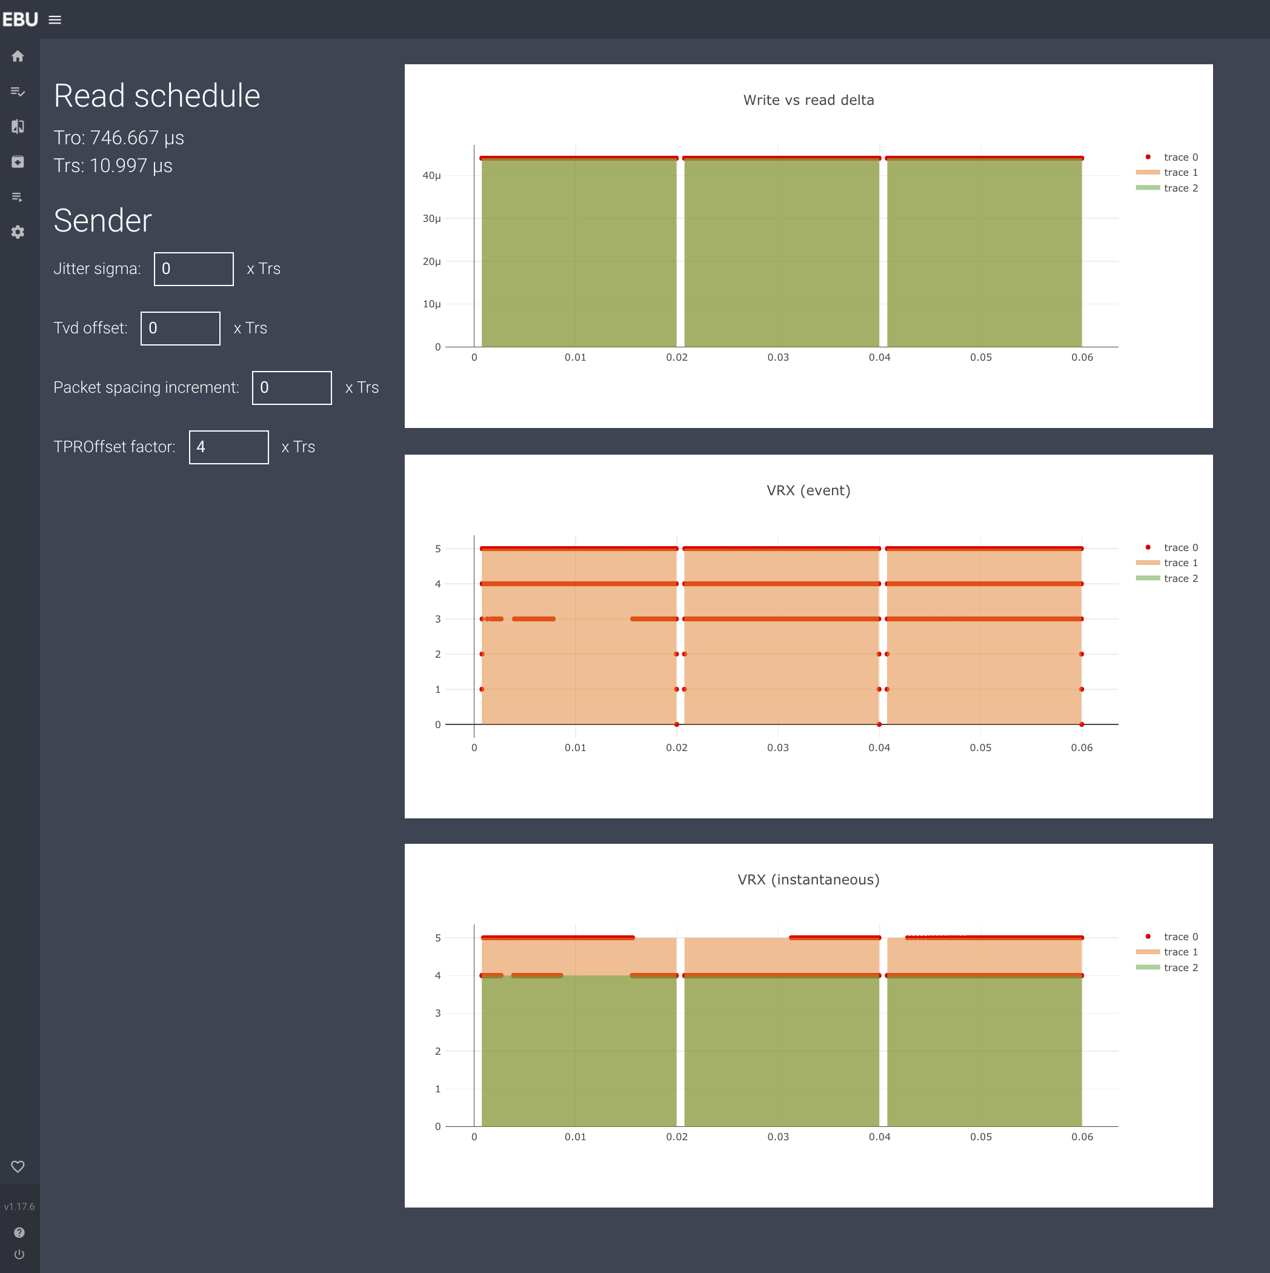
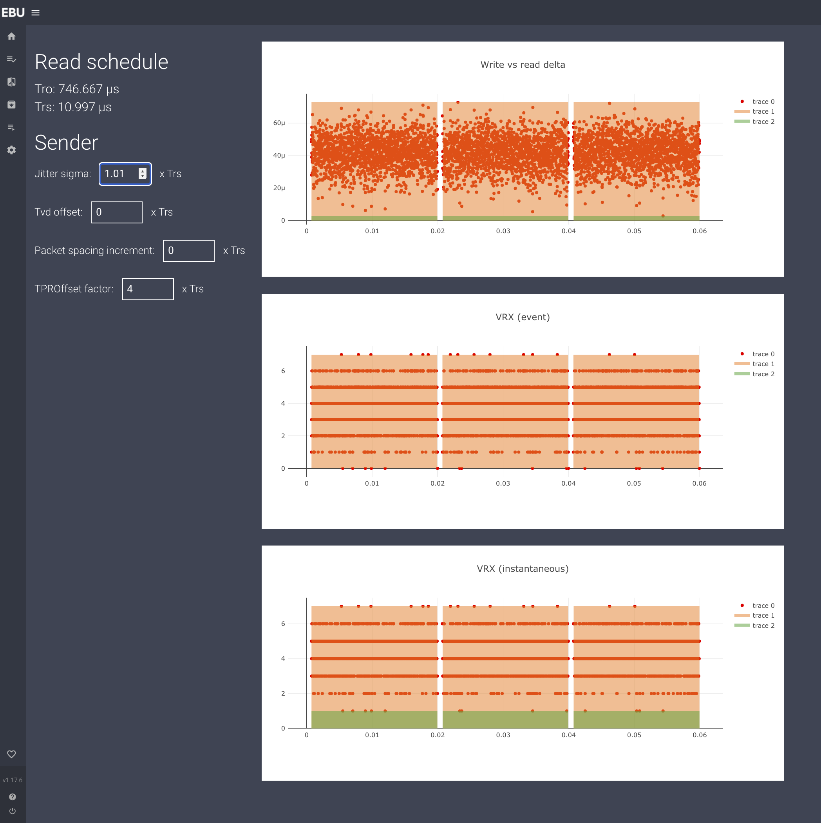
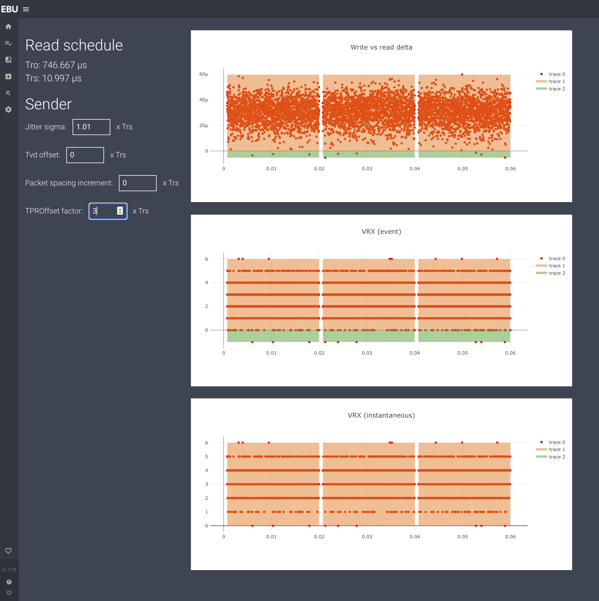

RP2110-25
MEASURING 2110-21
C_{PEAK} shall not exceed C_{MAX}
VRX_{PEAK} shall not exceed VRX_{FULL}
No formulas, but algorithms. More fun!
EBU
TECHNOLOGY & INNOVATION

Slide 15
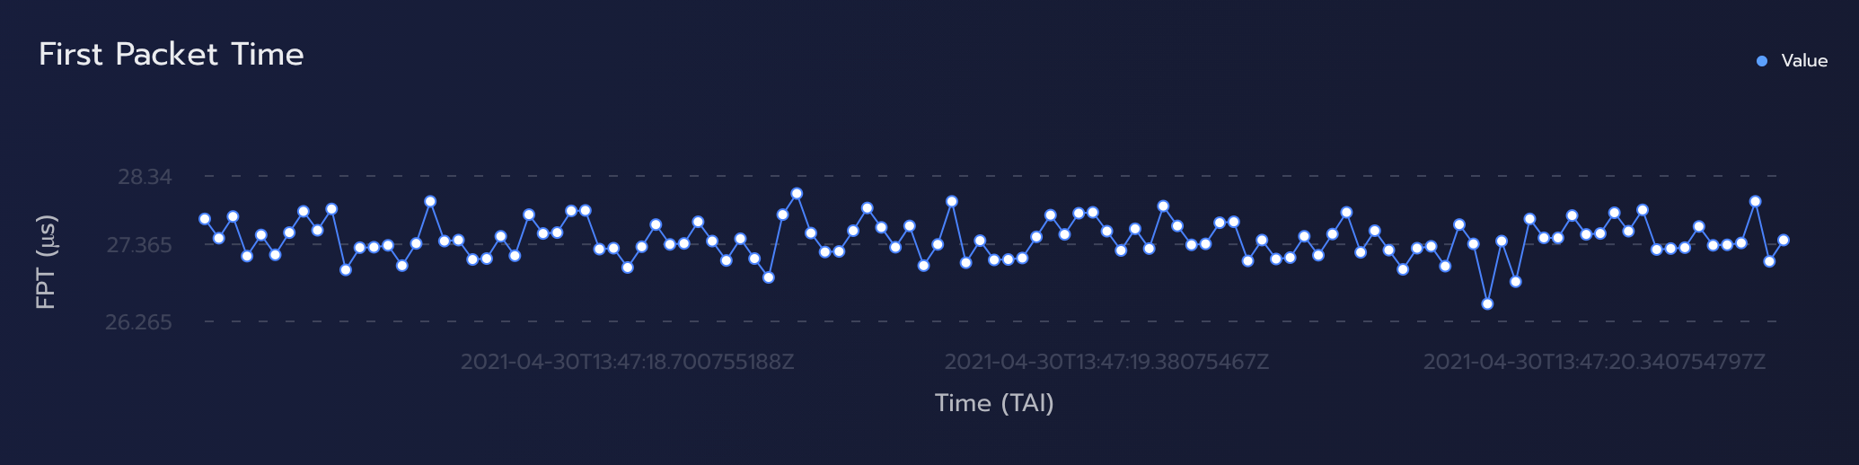
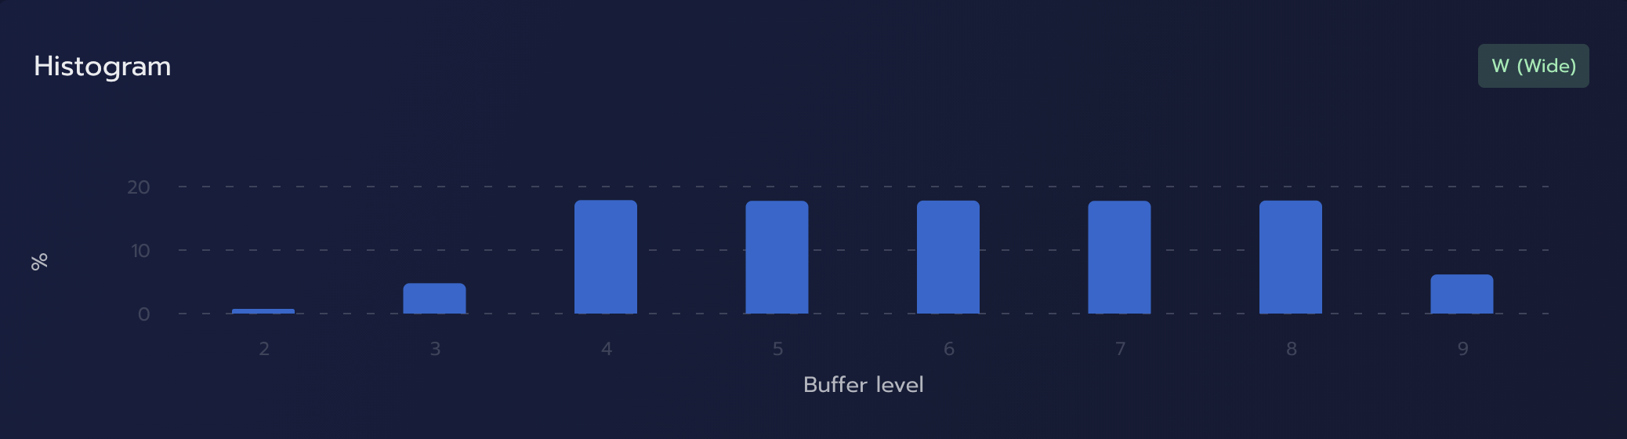
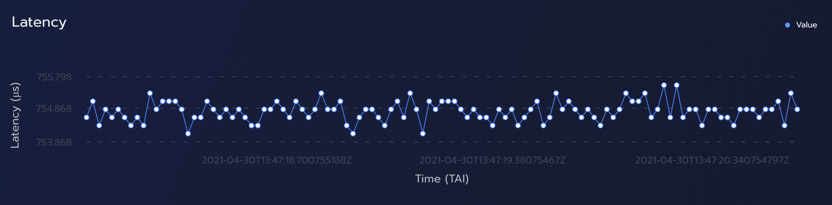
EBULIST
2.2
Notes:
As discussed, we can graph the FPT or first packet time.
Show a histogram of the VRX buffer.
The third graph we did not touch upon in the presentation.
Even from day one, we thought it was very important to Look at the Time represented by the RTP timestamp and compare this to TPA0, the first packet of the frame.
It could give you an indication about the latency of the system or the method that was used to create the timestamp. (at scen time, at egress, and so forth ...)
Now you might think, It sound familiar. But it does not look familiar.
And right you are!!
I'm very proud today to announce EBU-LIST 2.0.0
We did rebuild the inerface from the ground up, so many more people would be able to use this simple tool as a deep

Slide 16
What is a PICS?
A Protocol Implementation Conformance Statement (PICS) is a structured document which asserts which specific requirements are met by a given implementation of a protocol standard.
AES67-2018 was the first revision of the AES67 standard to include PICS for this standard. We used it as an example.

Slide 17
PICS Benefits
Helps implementers by providing a checklist of requirements
Helps implementers by providing additional clarifications to some of the requirements
Helps users by listing all the requirements and exact options that were implemented
Helps users ensure interoperation between two implementations

Slide 18
PICS Benefits
Helps in procurement - might be utilized for tender procedures
Helps in testing – provides a basis for preparing tests to be used to determine conformance of an implementation to the standard. Will be used in JTNM-Tested.

Slide 19
SMPTE ST 2110 PICS
Format:
  Separate document – Recommended Practice
Naming:
  Number of the original document plus 100:
Pics for ST 2110-10 is in RP 2110-110

Slide 20
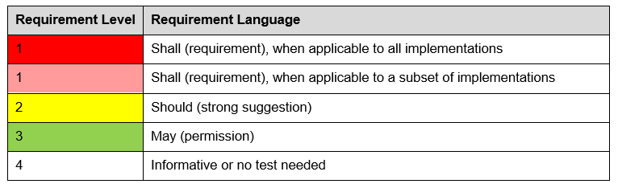
SMPTE ST 2110 PICS
Structure:
  Follows the original document, statement by statement, each statement is numbered
  Each requirement level is color-coded and numbered

Slide 21
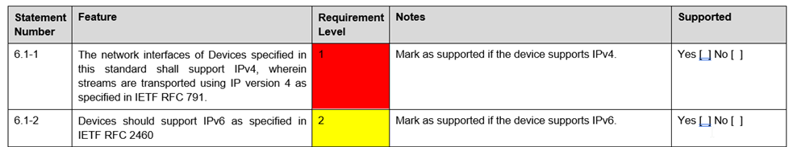
SMPTE ST 2110 PICS
The core of the proforma:
  The statement number
  The statement from the ST2110 document
  Requirement level
  “Notes” column with criteria for making the decision. Eventually comments or further clarifications of original document’s statement are also provided here
  “Supported” column with the decision in “Yes/No” format

Slide 22
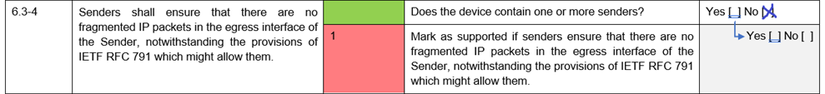
SMPTE ST 2110 PICS
Statements applicable only to a subset of implementations:
  The additional question that strictly defines if the statement is applicable to the implementation
  A special color for the requirement level to differentiate between the strongest “shall” statements that apply to all implementations and those that apply only to a subset of implementations

Slide 23
Conclusions
Number of practical problems have emerged
Addressed with
  JT-NM Tested
  SMPTE PICS
  ST 2110-25

Slide 24
Any Questions?

