Slide 1
Audio in IP production
Andy Rayner, Chief Technologist, Nevion
arayner@nevion.com +44 7711 196609
Come and catch up on the Sony stand in Hall 13

Slide 2
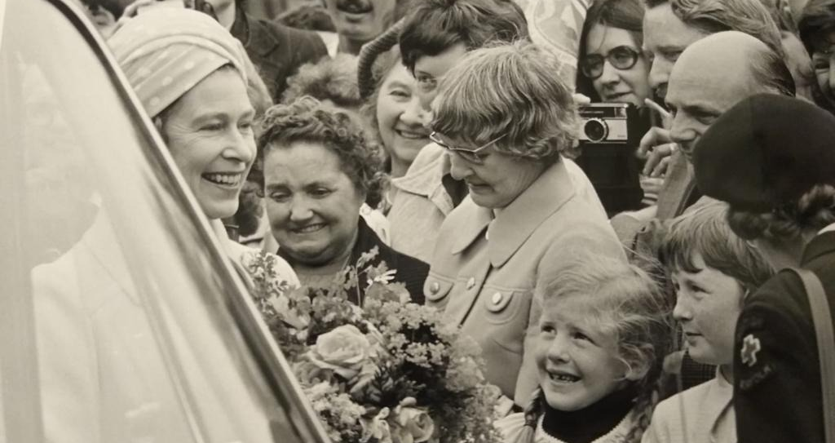
Queen Elizabeth II 1926-2022
The Queen
and I

Slide 3
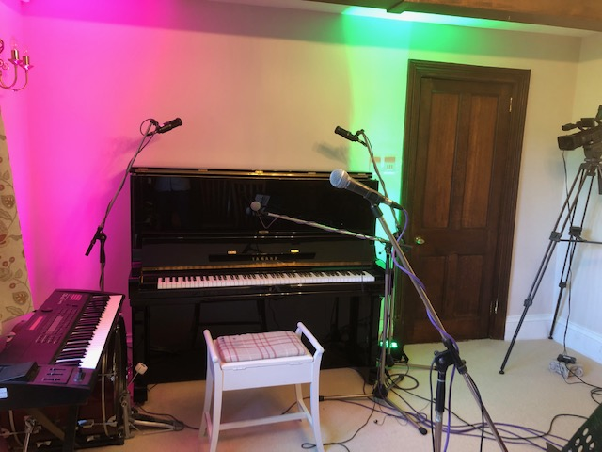
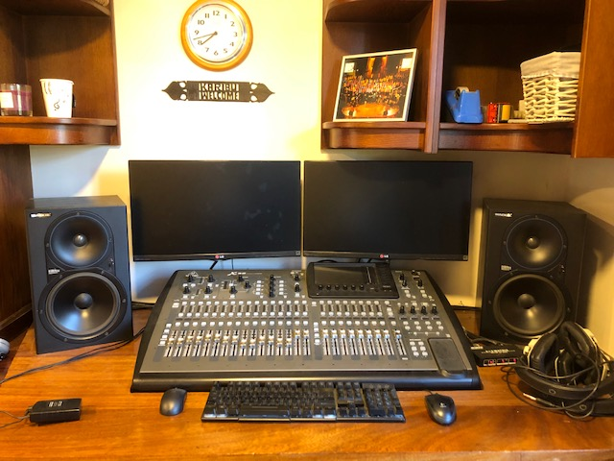
Don’t forget the audio- I am an sound guy!

Slide 4




Distributed production
Management
Home
5G
Public Cloud
Central facility
Event location or regional facilities
OB truck or local production
Private Cloud

Slide 5
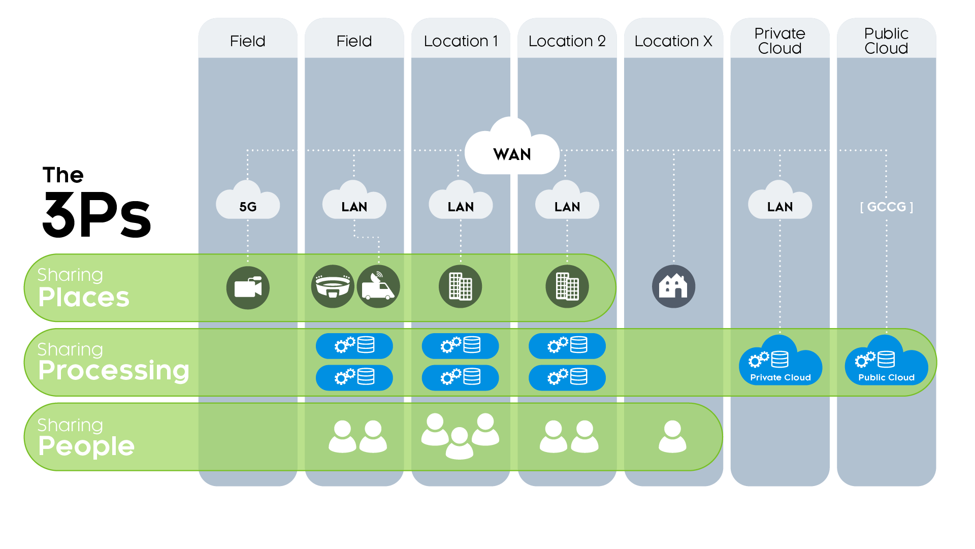
IP transformation - Places, Processing & People
Notes:
Our aim is to allow our customers to “create of compelling content anywhere, anytime and on any scale”.
We believe that requires our customers to be able to tap into the very best production resources everytime – the 3 Ps:
Places – ie. studios, control rooms, OB vans, etc
Processing – ie video and audio processing, such as switchers
People – i.e. the production team
Our mission is to enable all these resources to be included in the production, regardless of where they are.
How?

Slide 6



Audio requirements drive scale in facilities
AUDIO -30

Slide 7
The Audio folks did facility IP first!
‘Most of the complexity of a production environment is the audio’
Dante 2006 Ravenna 2010

Slide 8

Audio facility interconnects
Event/
alternate
location
Production
Center
Re-sync
Remote commentary location
Re-sync

Slide 9
History of sampling - PCM is 100 years old!
Determining sampling rate
Williard M. Miner, "Multiplex Telephony," U.S. Patent 745,734,
Filed February 26, 1903
Then Nyquist in 1924
The First Disclosure of PCM: Paul M. Rainey,
"Facimile Telegraph System," U.S. Patent 1,608,527,
Filed July 20, 1921,

Slide 10
A-D conversion!
1954 "DATRAC" 11-bit, 50-kSPS Vacuum Tube ADC
Designed by Bernard M. Gordon at EPSCO
500watts, 150lbs, $8500
AD572 12-Bit, 25-μs Mil
Hybrid ADC, 1977

Slide 11
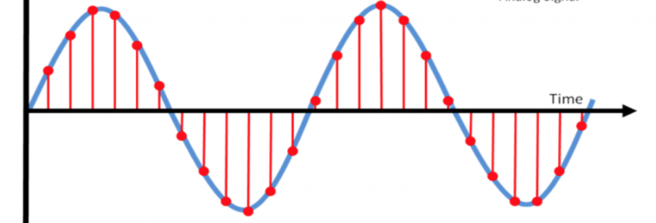
Audio acquisition
Sample frequency
Bit depth
Time of capture

Slide 12
Lots of different audio interfaces and formats!
Standardized Audio
interfaces
Standardized
IP formats
Analogue
EBU 3326
AES3
AES67
SDI embedded
ST2110-30/31
IP 2022-6
embedded
Proprietary
IP formats
Livewire
IP - 3326
DANTE
IP - AES67
RAVENNA
AES10 MADI
WheatNet
AES50
AoE
Q-LAN

Slide 13
Audio production interoperability
Audio data flows – almost identical
Audio control plane – very different

Slide 14
Audio parameters……………lots of choices
AES3: 2 channels
Sample rate: 16kHz, 22kHz,32kHz,44.1kHz,48kHz,88.1kHz,96kHz,192kHz
Bit depth: 16bit, 20bit, 24bit
AES3 frame period: 1ms – 12ms
AES10 - MADI: 28, 56, 64 channels
Sample rate: 32kHz - 96kHz
Bit depth: 16bit, 20bit, 24bit
AES67: 1 - 120 channels (1-8)
Sample rate: 44.1kHz, 48kHz, 96kHz
Bit depth: 16bit, 24bit
IP Packet period: 125us, 250us, 333⅓us, 1ms, 4ms
ST2110-30: 1-8 channels (1-64 channels Level C)
Sample rate: 48kHz (level A), 96kHz (level –x)
Bit depth: 16bit, 24bit
IP Packet period: 1ms (level A)125us (level B),

Slide 15







The ST2110 suite & NMOS
SYSTEM -10
VIDEO -20
AUDIO -30
AES3-32 bit
AUDIO -31
ANCILLARY
DATA -40
TIMING -21
COMPRESSED
VIDEO -22
MULTI-PART VIDEO -23
SD
VIDEO -24
FAST METADATA -41
FMX -42
2022-8
COMPOSITE
BCP-003-0x
Security suite
IS-04
Discovery and Registration
IS-05
Connection Management
IS-07
Event and Tally
IS-08
Audio Channel Mapping
IS-09
System

Slide 16
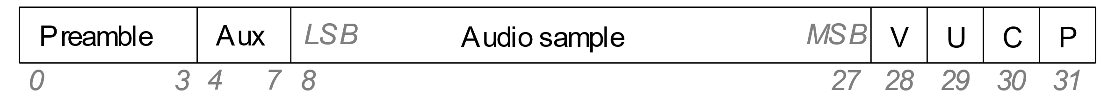
Handling ‘other’ audio: the ST2110-31 bits
AUDIO -30
AES3-32 bit
AUDIO -31

Slide 17
Timing and referencing
ST2059 – applying PTP IEEE1588 to media
GNSS
TaaS
GPS

Slide 18

Origination time stamping in RTP
Media payload
RTP
UDP
IP
VLAN
MAC/PoS/
GFP/MPLS

Slide 19
Audio per-sample timing
TS=n
TS=n+1
TS=n+2

Slide 20

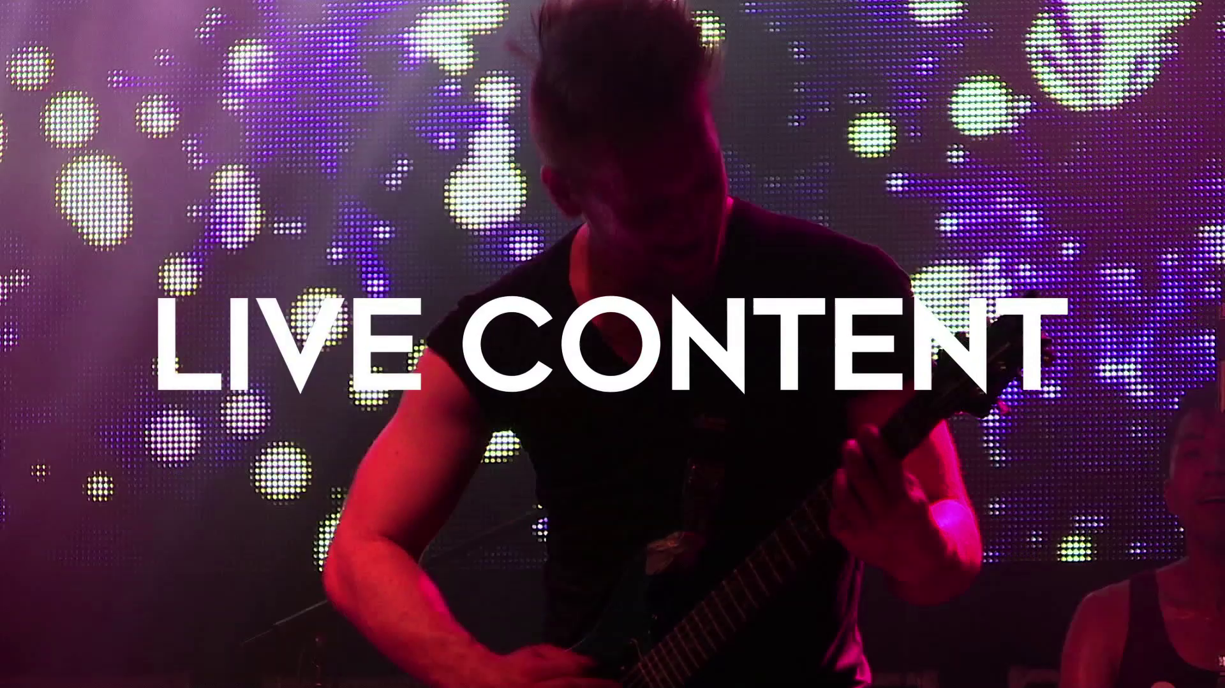
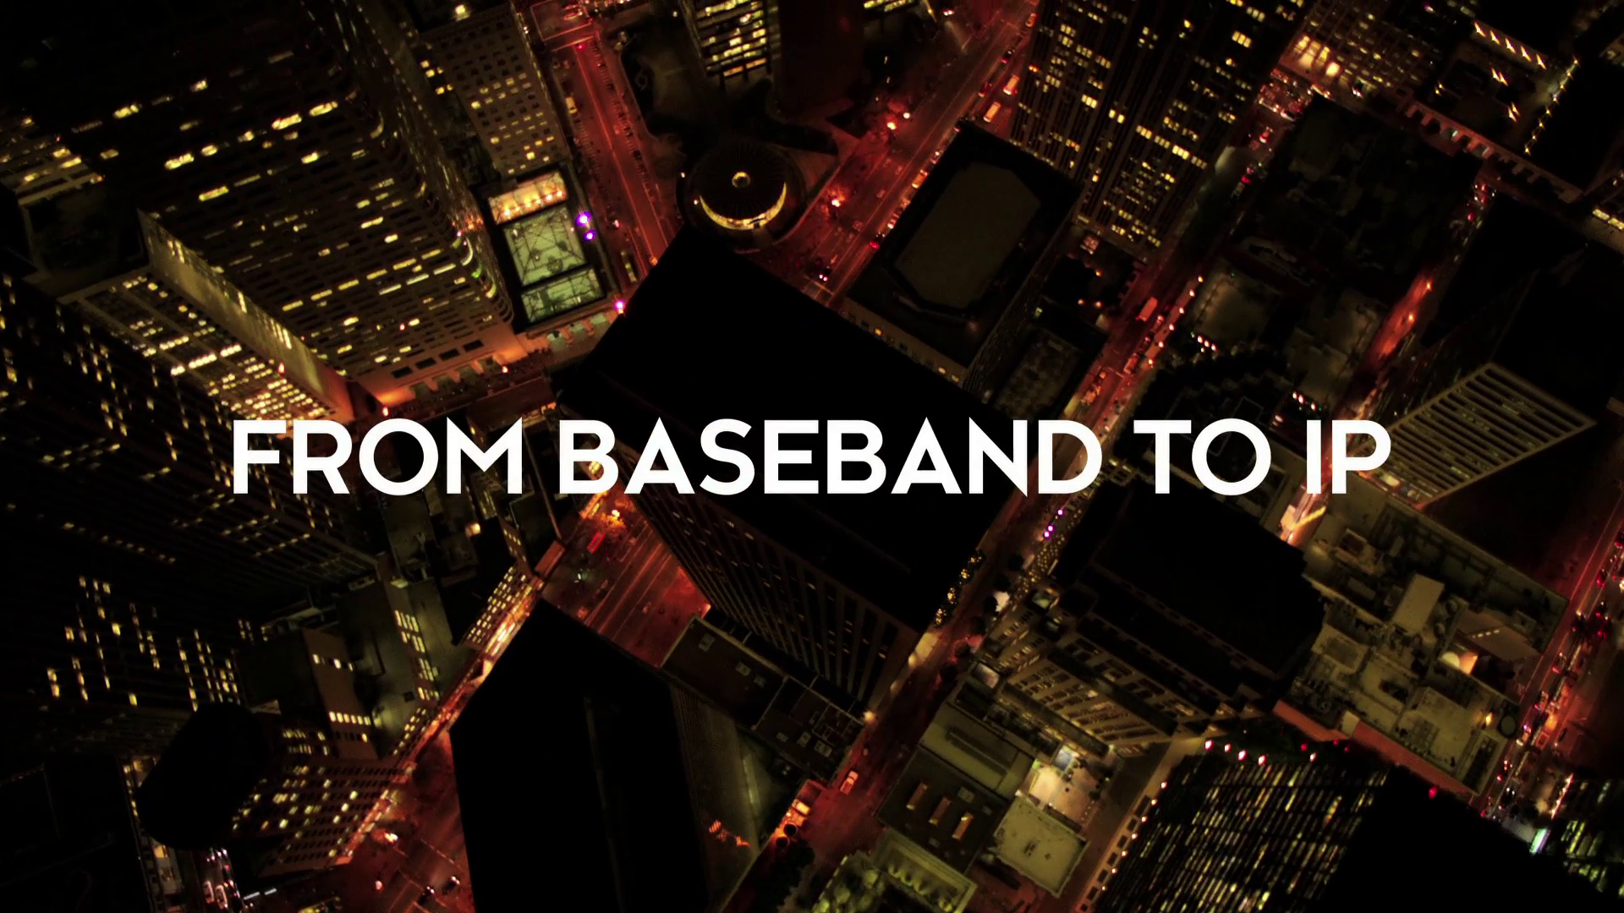

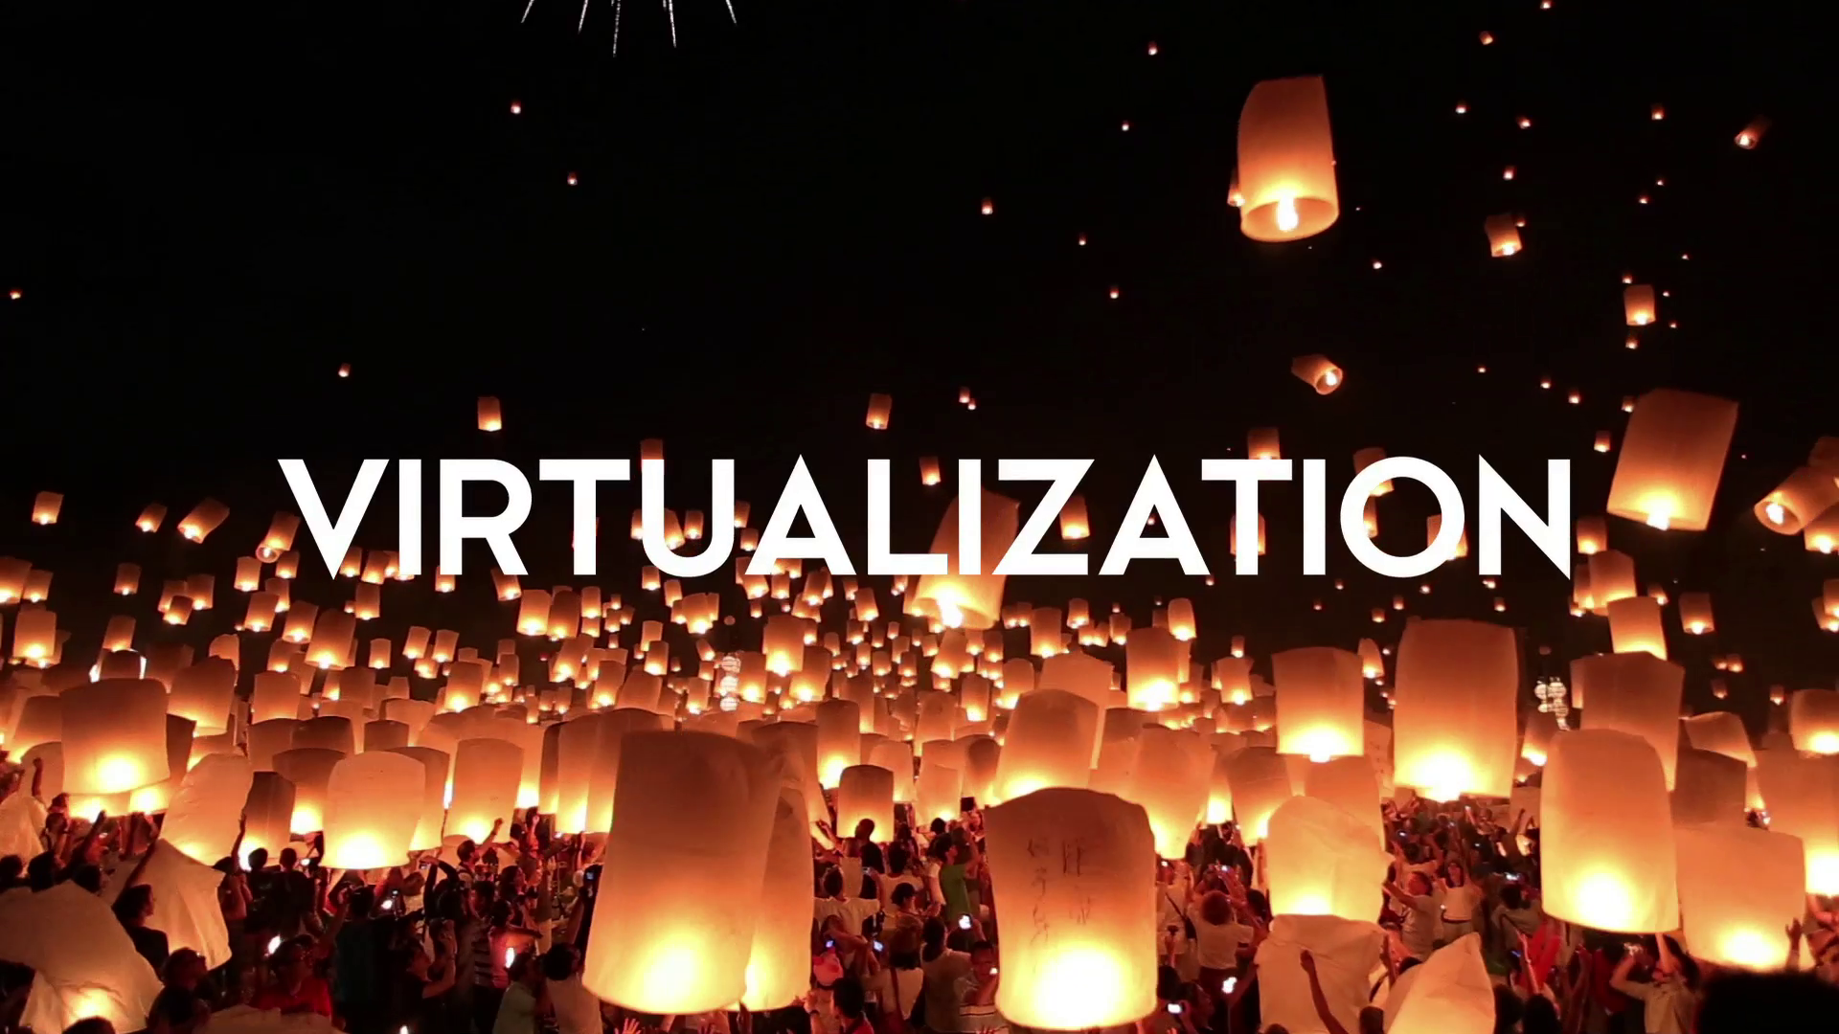

Video – per-frame sampling timing
e.g. 20ms
ST2110-20 freezes
RTP timestamp!
Time

Slide 21


What about the standardized control plane?
Controller
Audio data stream
Audio data stream
IS-04, IS-05, IS-08

Slide 22
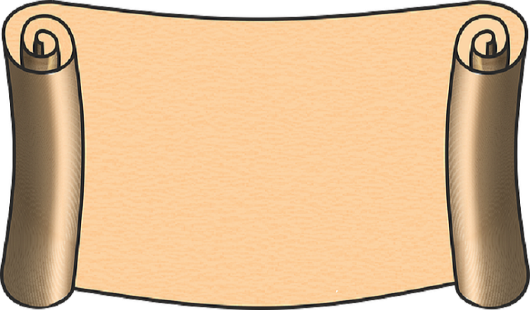
The SDP - RFC 4566 – used in ST2110
FAST METADATA -41
Sender description
Video and/or audio essence
Raster size (in pixels)
Frame-rate (video)
Channel count (audio)
Sampling structure (audio/video)
Bit depth (audio/video)
Colorimetry
Source IP address and port
RTP payload ID (audio/video)
PTP grandmaster source and domain
FMX -42
Coming soon

Slide 23



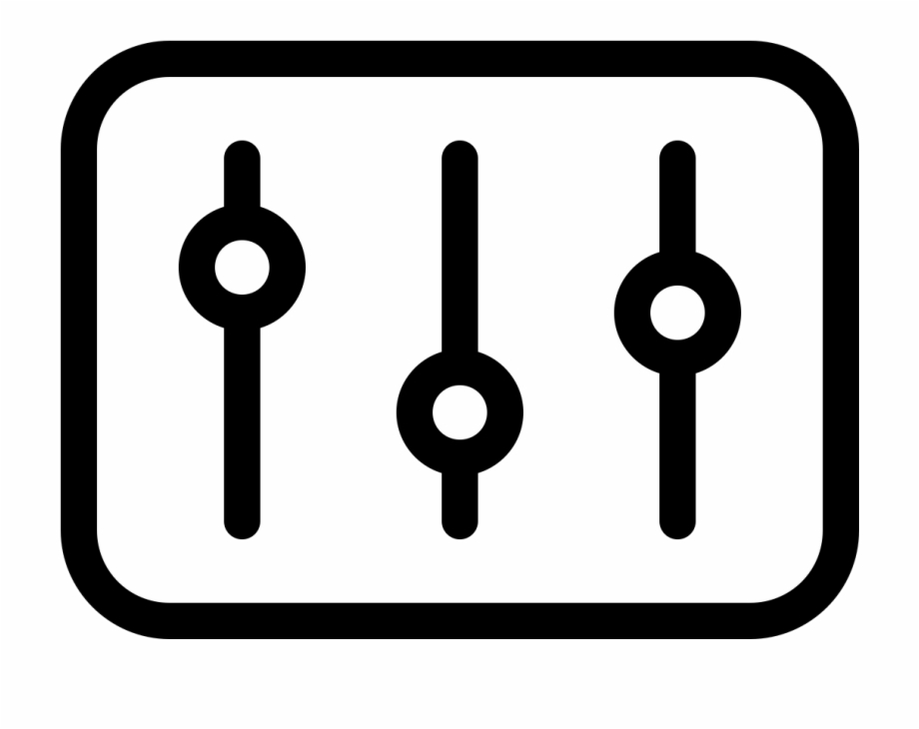
Audio manipulation required in IP domain
IP
IP
GAIN
DELAY
SHUFFLE
DOWNMIX

Slide 24

How to shuffle in the modern world
Mono AES67
Mono AES67
Mono AES67
Mono AES67
Mono AES67
Mono AES67
Mono AES67
Mono AES67
AES67 1-64ch
IP audio proc
AES67 1-64ch
AES67 1-64ch
AES67 1-64ch
AES67 1-64ch
AES67 1-64ch
AES67 1-64ch
AES67 1-64ch
End device selects
AES67 1-64ch

Slide 25



Audio templates – a few practical options
One channel - mono
Two channels - stereo
Six channels – 5.1
Eight channels – 4 x stereo

Slide 26
Video-associated audio format interfacing
16 Mono
SDI
SDI
16 Mono
16 Mono
SDI
SDI
16 Mono
16 Mono
SDI
SDI
16 Mono
16 Mono
SDI
SDI
16 Mono
8 Mono
ST2110-30
ST2110-30
8 Mono
8 Mono
ST2110-30
ST2110-30
8 Mono
8 Mono
ST2110-30
ST2110-30
8 Mono
8 Mono
ST2110-30
ST2110-30
8 Mono
16 Mono
ST 2022-6
ST 2022-6
16 Mono
16 Mono
ST 2022-6
ST 2022-6
16 Mono
16 Mono
ST 2022-6
ST 2022-6
16 Mono
16 Mono
ST 2022-6
ST 2022-6
16 Mono

Slide 27
Audio-only format interfacing
64 Mono
MADI
Async in
16 Mono
64 Mono
MADI
Async in
16 Mono
64 Mono
MADI
Async in
16 Mono
64 Mono
MADI
Async in
16 Mono
64 Mono
AES67
2100-30
8 Mono
64 Mono
AES67
2110-30
8 Mono
64 Mono
AES67
2110-30
8 Mono
64 Mono
AES67
2110-30
8 Mono
16 stereo
AES3
2110-31
16 Mono
16 Mono
Analogue
2110-31
16 Mono
16 stereo
AES3
2110-31
16 Mono
16 Mono
Analogue
2110-31
16 Mono

Slide 28
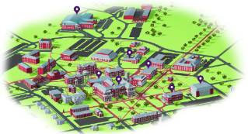

Moving outside the campus – distributed production
WAN connectivity involved
Longer latencies
(Potentially) Asynchronous sources
Layer 2 too limiting
Layer 3 (routed)
needed for larger
and multi-campus
networks
PTP GM
PTP GM

Slide 29


Interconnecting proprietary audio Islands
Gateway via ‘tie-lines’
SDN interconnect
Plug and play ‘toolkit’ needed to transition to standardised formats

Slide 30


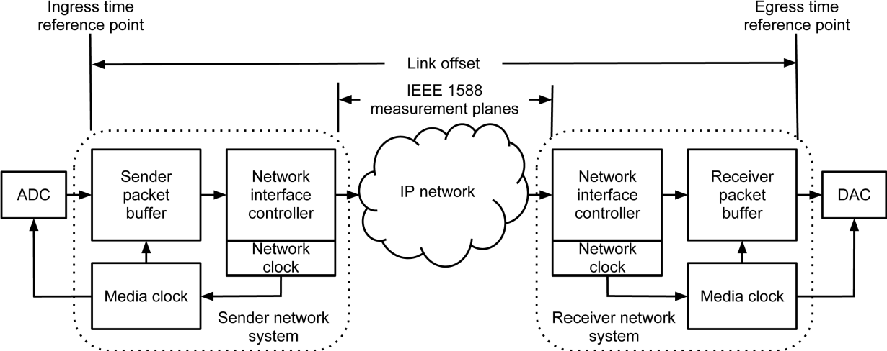
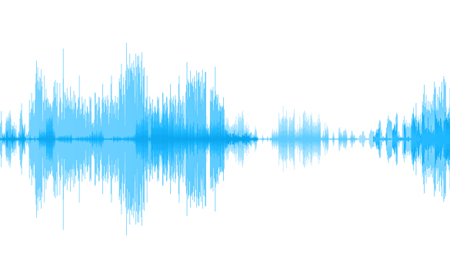
AES67 – defines link offset
link time

Slide 31

Hybrid timing reconciliation
Control
system
Provides
time coord
Some chain timing preservation
Origination
time
link time
Processing time
Processing time
link time
Use time
link time
link time
link time
Processing time

Slide 32

PTP holdover is capable of being very long – let’s make it so!

Slide 33
Protection – on and off campus – video & audio
flow A
n
n+1
n+2
n+3
(1,1)
(2,1)
(L,1)
n+4
n+5
n+6
n+7
SOURCE
Spatial
DESTINATION
(1,2)
(2,2)
n+8
n+9
n+10
n+11
n+12
n+13
n+14
n+15
flow B
n+16
n+17
n+18
n+19
(1,D)
(L,D)
n+20
n+21
n+22
n+23
1
2
L
n+24
n+25
n+26
n+27
flow A
n+28
n+29
n+30
n+31
Spatial +
temporal
n+32
n+33
n+34
n+35
SOURCE
FEC
DESTINATION
n+36
n+37
n+38
n+39
delay
n+40
n+41
n+42
n+43
flow B

Slide 34
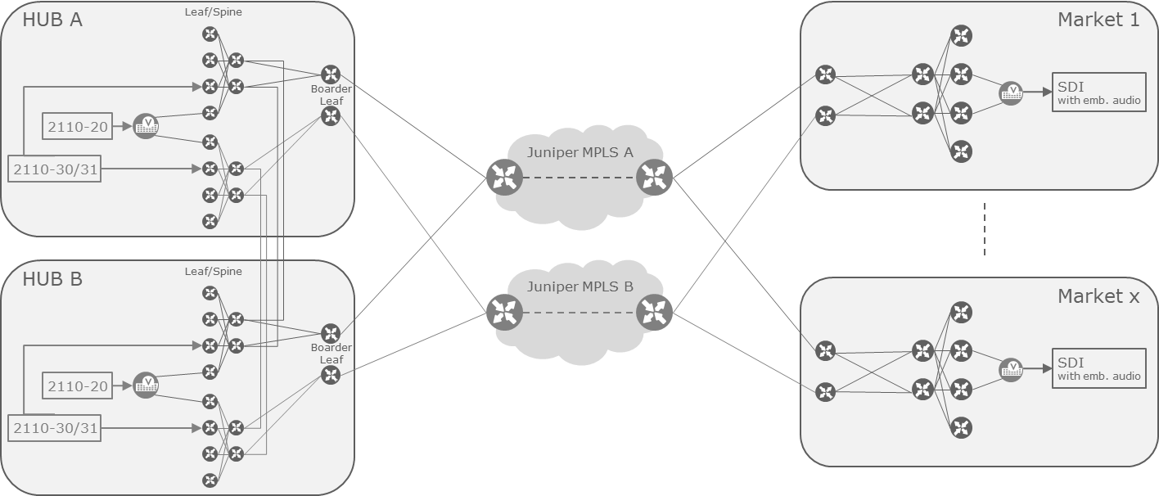
International use case - Audio signal flows
Orchestration

Slide 35

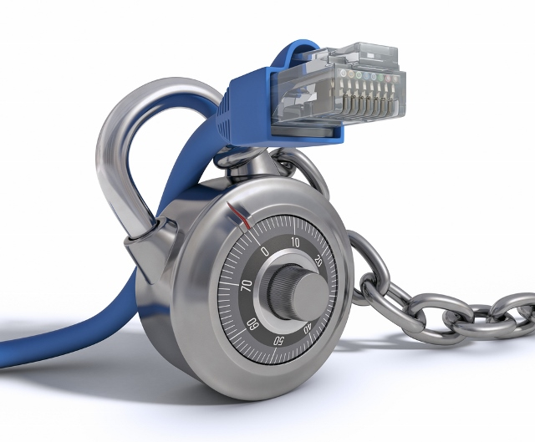

Secure networks need managed networks
SDN control

Slide 36

Going off-campus – the IP facility media edge
PTP TIMING
ALTERNATIVE TIMING DOMAINS
DEVICE
DISCOVERY & CTL
RESTRICTED/PROXY
DISCOVERY & CTL
MEDIA FLOW IP ADDRESSING
DIFFERENT IP ADDRESSING (NAT)
UNCOMPRESSED ESSENCE FLOWS
ESSENCE/COMPOSITE
UN/COMPRESSED FLOWS
PROTECTION
TERMINATION
PROTECTION
TERMINATION
‘EXOTIC’
PROTOCOLS

Slide 37
ST2110-WAN AG - two layers of focus – data and control
Media essences
data flows
Registration, discovery and control

Slide 38
ST2110-WAN
Facility 1
WAN
Facility 2
TR-09 Gateway G1
TR-09 Gateway G2
NMOS Resource Proxying
NMOS Resource Proxying
CONTROL
PLANE
Encoding
Encryption
Error Protection
Encapsulation
Decoding
Decryption
Error Correction
Decapsulation
DATA
PLANE
Notes:
If we want to be able to share resources between different geographical locations in an interoperable way, we need standards and specifications that different manufacturers can all follow.
This is what the VSF’s ST 2110 over WAN group have been working on over the last couple of years. This will soon be published as TR-09.
We’ve tackled how to share 2110 media flows over a WAN both from the perspective of the data plane and the control plane.
For the data plane, considerations have included things such as:
- Encoding – compressing the media flows to save bandwidth whilst maintaining quality and low latency, using standards such as JPEG-XS
- Encryption – ensuring the data flows are secure
- Error protection – ensuring the data can get over the WAN even if the channel is less than perfect, using techniques such as forward error correction, RIST and 2022-7
- Encapsulation – ensuring that associated flows can arrive together across the WAN to assist synchronisation and to allow things like the forward error correction to be shared across flows. This is done by trunking the flows together.

Slide 39
2110-WAN control plane
Facility 1
WAN
Facility 2
TR-09 Gateway G1
TR-09 Gateway G2
NMOS Resource Proxying
CONTROL
PLANE
NMOS Resource Proxying
Sender
Proxy Receiver
Proxy Sender
Proxy Receiver
Proxy Sender
Receiver
IS-04
Query API
Calls IS-04
Query API
IS-05
Conn API
Calls IS-05
Conn API
IS-10
Auth API
Calls IS-10
Auth API
Notes:
For the control plane, we’ve proposed to use an NMOS-based approach.
We had several requirements:
- To allow only a subset of resources to be shared across the WAN, i.e. so Facility 1 can choose exactly which resources it shares with Facility 2 (we proxy resources using a Gateway to achieve this)
- To prevent Facility 2 from having any view of anything else going on in Facility 1 (Facility 2 only talks to the Gateway, nothing internal to Facility 1)
- To “not invent anything new” if at all possible (hence an NMOS-based approach using IS-04 and IS-05 with minimal additions and no required NMOS spec changes)
- To ensure all the control communications are secure, both in terms of being encrypted and in terms of authorisation - so that only an authorised second facility can access the control APIs of the first facility (using IS-10)
- To allow the method to be extendable to do things such as audio channel shuffling (using IS-08) or allowing a back channel control/tally path (using IS-07)
- To ensure each facility is autonomous and can run by itself without any dependence on the other facility - except for the shared flows of course (no interdependence)
- To ensure that no additional independent resources are required to be spun up in the WAN – everything resides is in one facility or the other and is accessed via the WAN gateway
- To ensure resources can be booked ahead of time (tags-based approach with current booking and booking list)

Slide 40
The broadcast end game
Production
= real time
& time aligned
Acquisition
Consumption
Time-aware
media processing chain

Slide 41
Deterministic data transfer
Linear and non-linear
RTP/UDP
2022-7
FEC
ARQ
TCP
Infiniband
SRD

Slide 42
In conclusion
Event/
alternate
location
Production
Center
Re-sync
Remote commentary location
Re-sync

Slide 43

Thank you!
Andy Rayner Chief Technologist
arayner@nevion.com +44 7711 196609
Come and catch up on the Sony stand in Hall 13
Check out our other presentations on-line

Slide 44
Any Questions?

